Slide 1
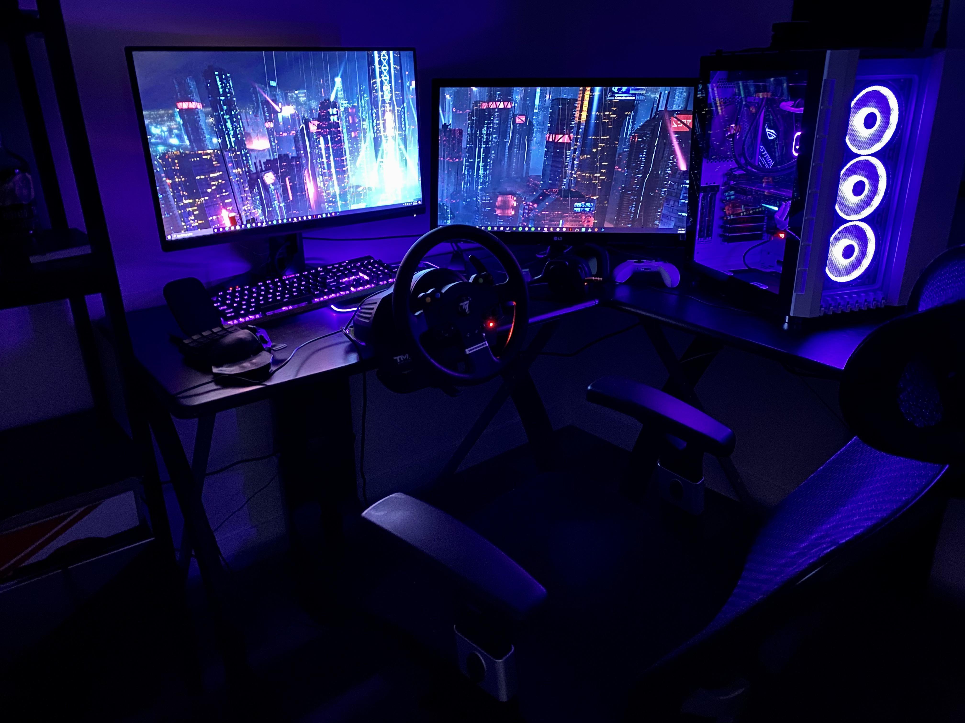
PC
BUILDING & GAMING
BY ADITYA LANDE
TEAM 1 JUHU
"Gamers never die, they respawn.”

Slide 2
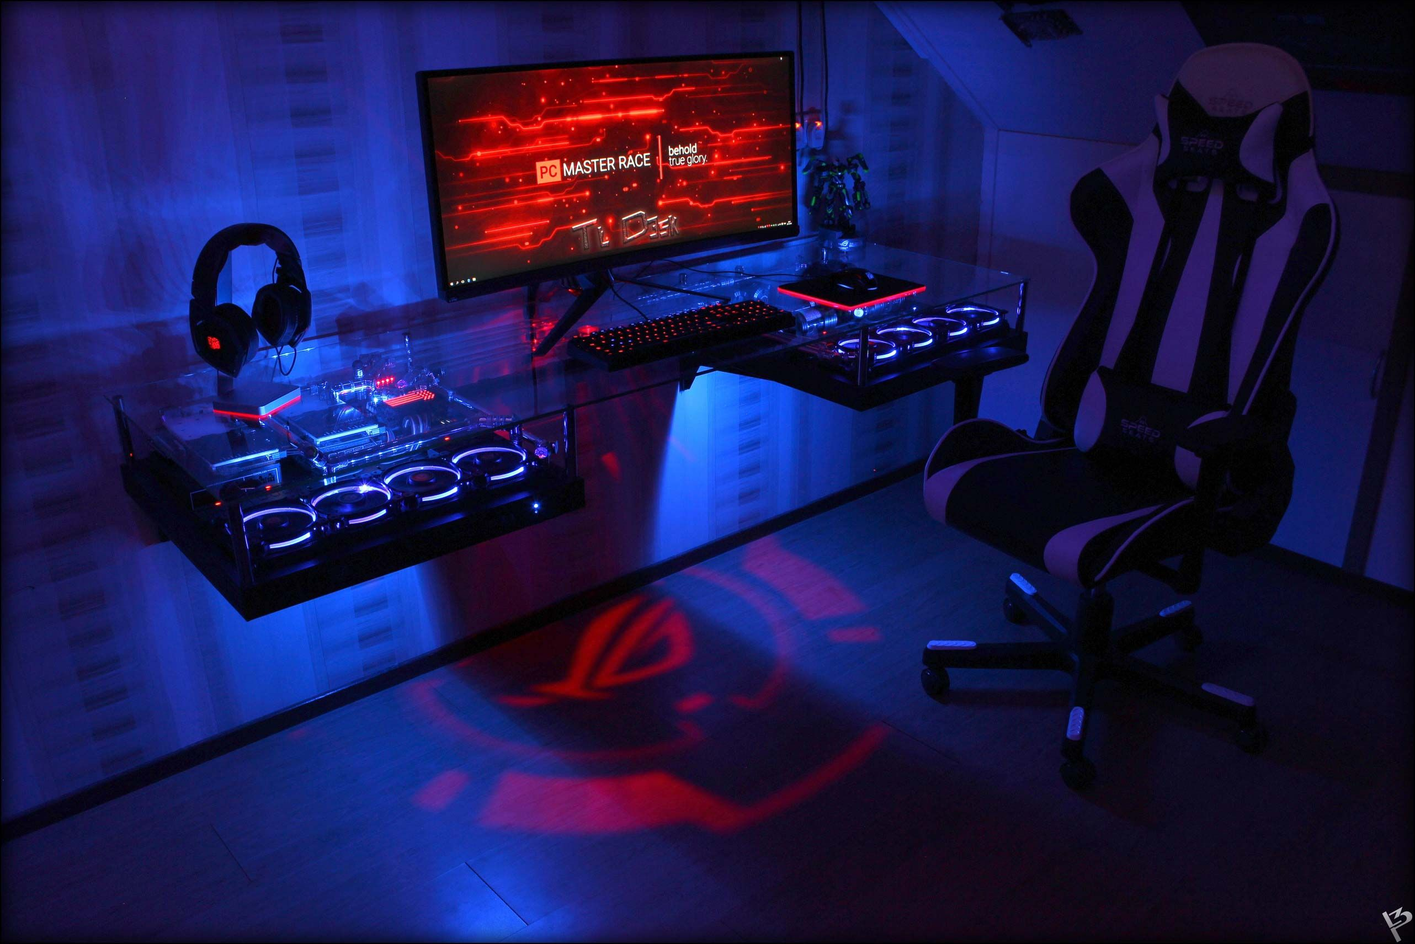
CONTENT
1
INTRODUCTION
2
PC BUILDING
3
PARTS REQUIRED FOR PC GAMING
4
KEY GAMING ACCESSORIES
5
ARTIFICIAL INTELLIGENCE IN VIDEO GAMES
6
GAMING PCS
7
GAMING CONSOLES
8
PERFORMANCE
9
ADVANTAGES & DISADVANTAGES
10
GAMES SELECTION & GAMES STORES

Slide 3
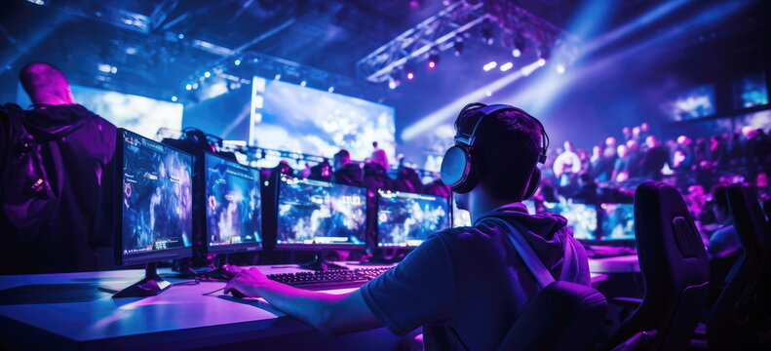
INTRODUCTION
A specialized personal computer designed for playing video games at high standards.
Gaming PCs typically differ from mainstream personal computers by using high-performance video card.
A high core-count CPU with raw performance and higher-performance RAM.

Slide 4
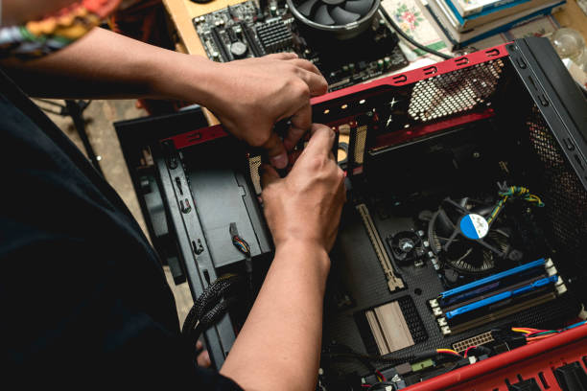
PC BUILDING
Building desktop PCs has become a popular hobby for most people, especially for those who play video games (known as "gamers").
Not only they can build a desktop that can outperform other pre-built models selling in retail stores.
Build their own computer by adding whatever components they want, ranging from multiple hard drives, case mods, high-performance graphics cards, liquid cooling, multi-head high-resolution monitor configurations.

Slide 5
PARTS REQUIRED FOR PC GAMING
Motherboard(Mainboard)
The motherboard acts as the 'backbone of the computer’
Motherboards come in a couple of flavours, but the most important thing to know is what kind of socket it has. There are basically two: LGA and AM.

Slide 6
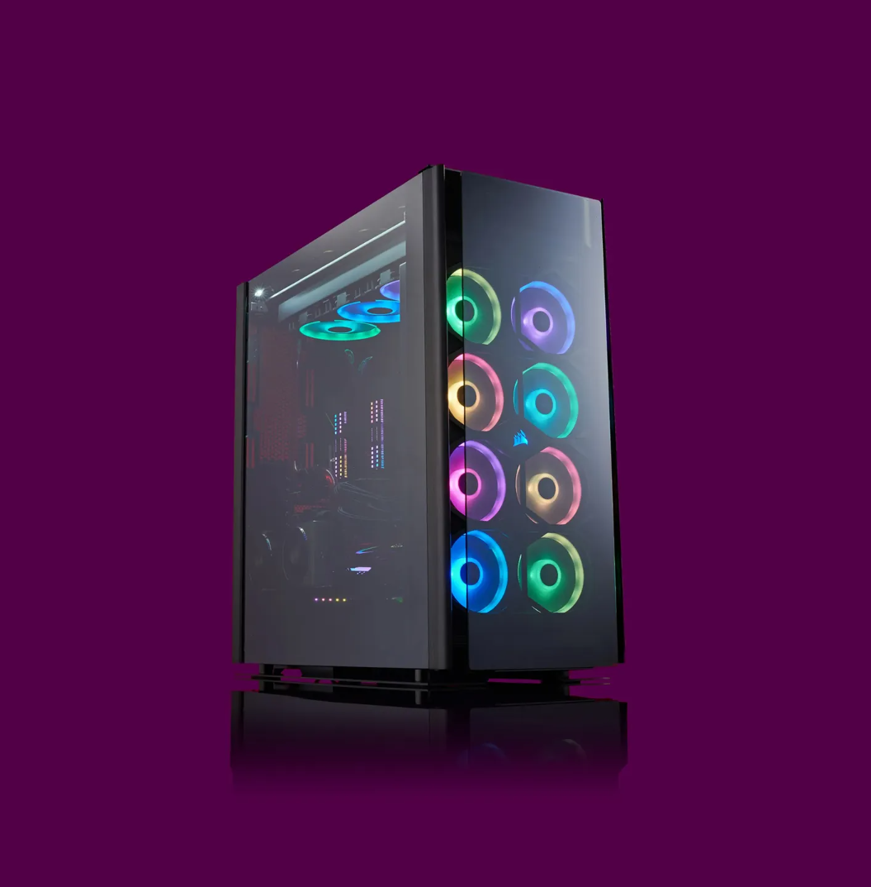
CPU(Central Processing Unit)
The CPU (central processing unit) is often referred to the brains of the computer
The CPU we selected is the Intel Core i5 CPU and above
Intel and AMD Ryzen

Slide 7
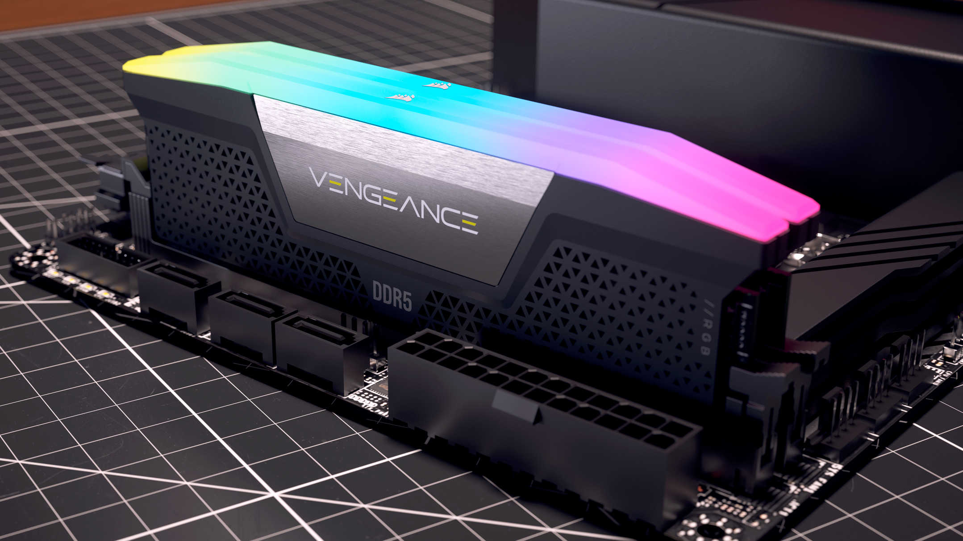
RAM(Random Access Memory)
Where game information is stored to be loaded or retrieved quickly.
Here gamers consider how much RAM they might need, the frequency at which data can be transferred and speed (latency) of that information.
Mostly DDR4, DDR5 are used
Trident, Samsung, Patriot Viper, Vengeance

Slide 8
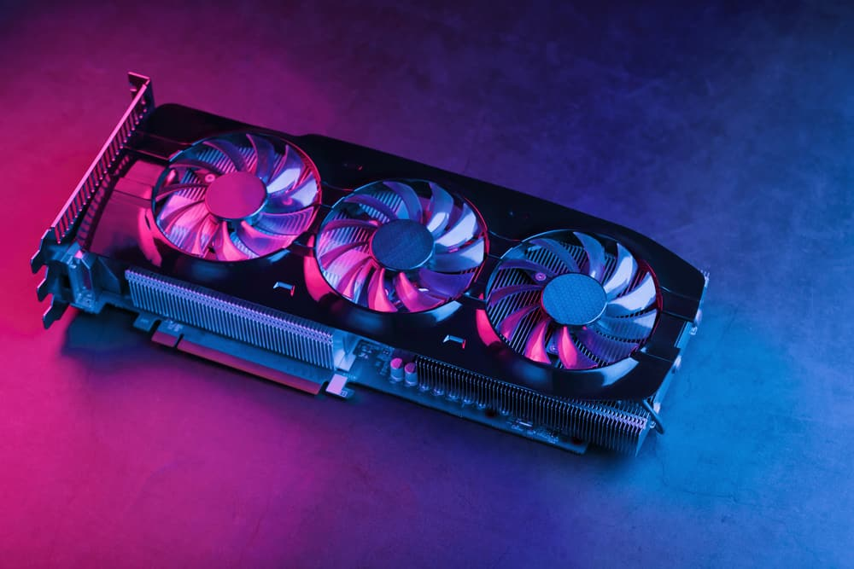
Graphic Card(GPU)
Major part required for gaming
A graphics card (also called a video card, display card, graphics adapter, VGA card/VGA, video adapter, display adapter, or colloquially GPU) is a computer expansion card that generates a feed of graphics output to a display device such as a monitor.
Nvidia GeForce
AMD Radeon

Slide 9
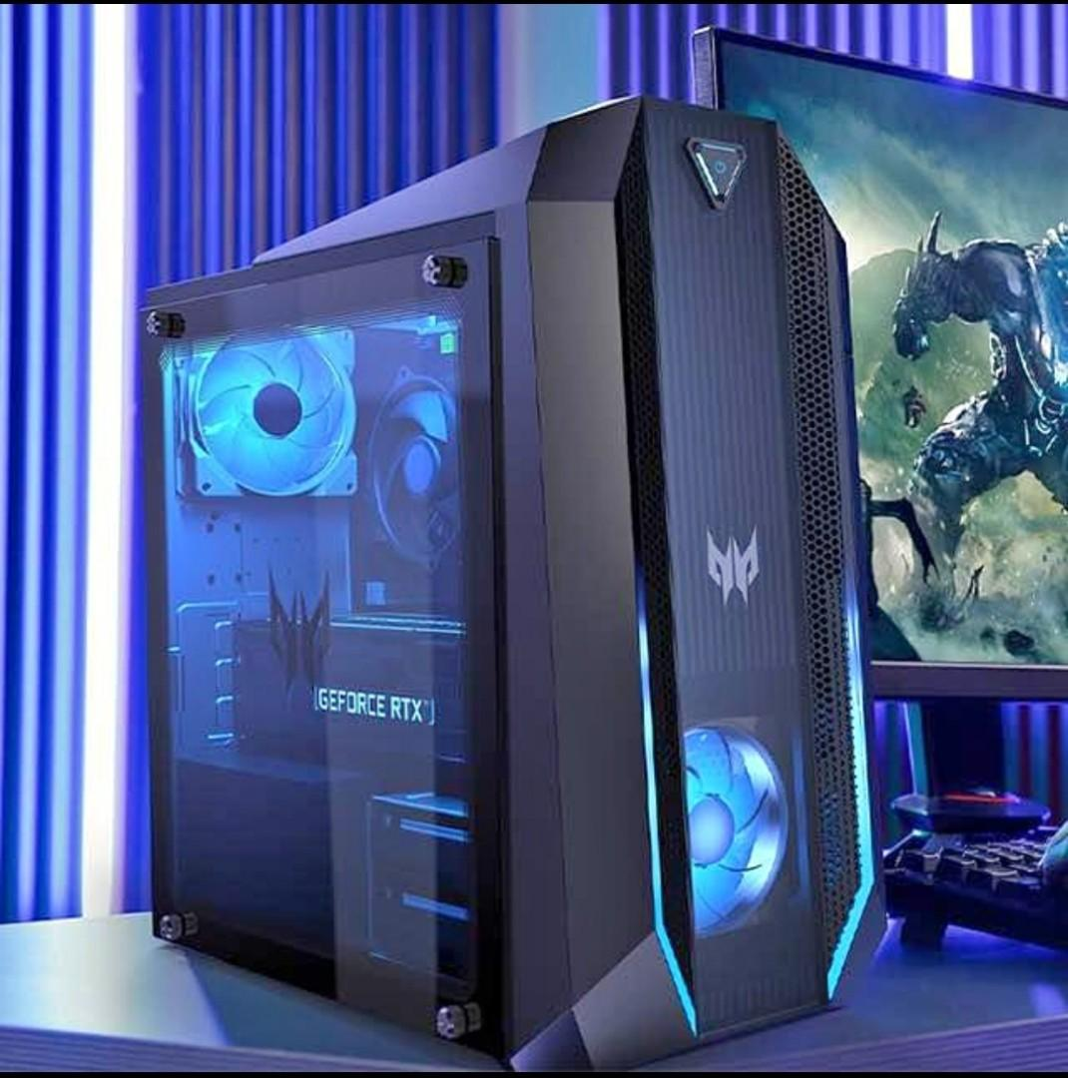
Gaming Case
Computer cases usually include sheet metal enclosures for a power supply unit and drive bays
We can modify our Computer cases to Gaming Case by RGB,s and RGB fans

Slide 10
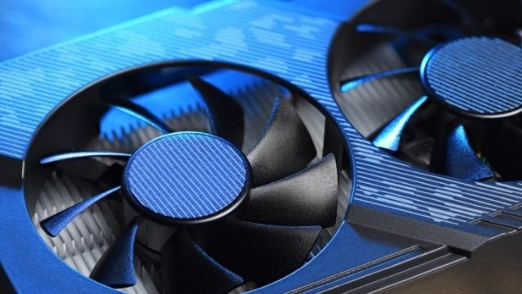
CPU Fans
A CPU fan is any fan inside, or attached to, a computer case used for active cooling.
Fans are used to draw cooler air into the case from the outside, expel warm air from inside and move air across a heat sink to cool a particular component.
Now a days Liquid Cooled CPU’s are used.
We can modify fans by RGB and lights.

Slide 11

Power Supply(PSU)
A power supply is an electrical device that supplies electric power to an electrical load.

Slide 12
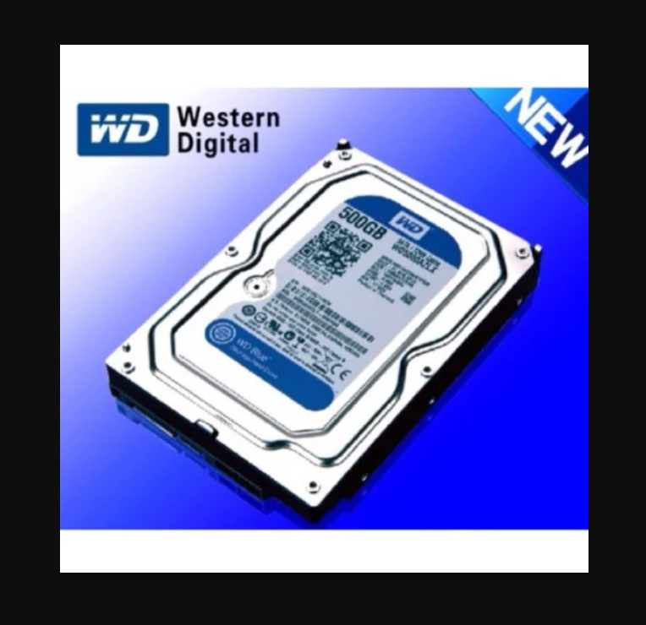
HDD(Hard Disk Drive)
Hard drive or Solid State Drive (SSD) is where game information, data, programs and other applications are stored on the computer permanently and retrieved when required.
Available in various sizes.

Slide 13
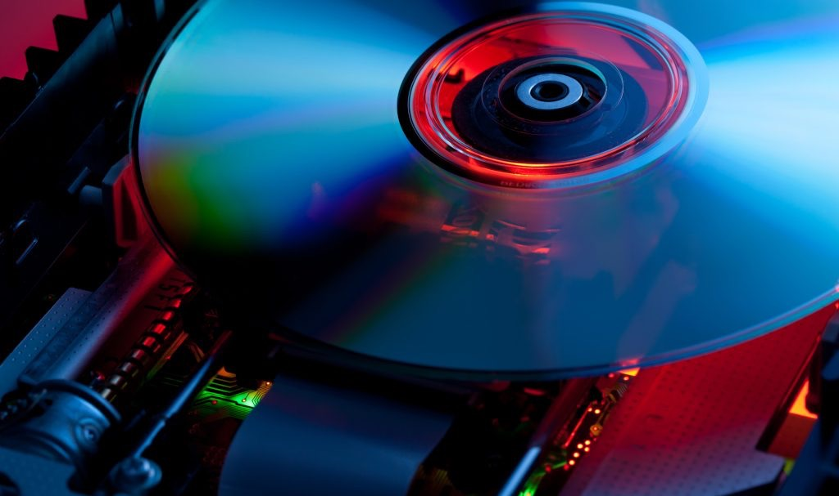
CD/DVD Drive
An optical disc drive is a disc drive that uses laser light or electromagnetic waves within or near the visible light spectrum as part of the process of reading or writing data to or from optical discs.
Used to store and share information

Slide 14
Display Monitor
LCD , LED
Backlights Monitors

Slide 15
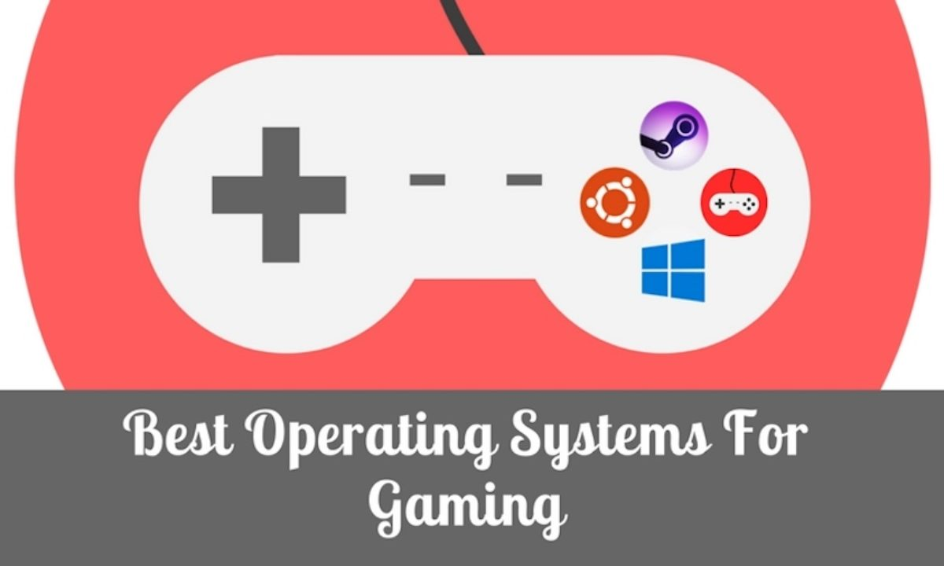
Operation System
Mostly Windows OS is Used for PC Gaming
Linux, Mac OS are also used

Slide 16
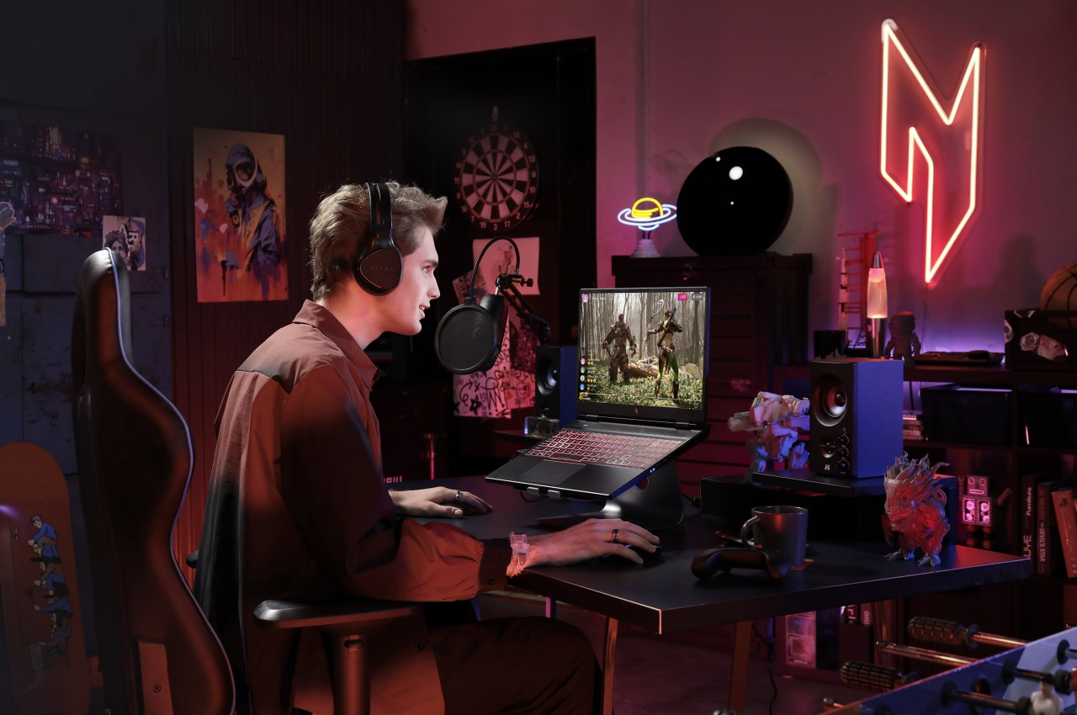
Gaming Laptops
No laptop is a true gaming machine unless it comes with a dedicated graphics processor (GPU).
Acer Predator , Asus ROG Strix, Razer Blade, HP Omen

Slide 17


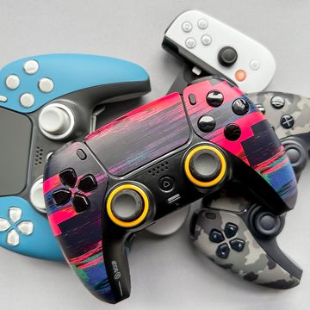
KEY GAMING ACCESSORIES
Keyboard Mouse
Gaming Headset
Controllers

Slide 18
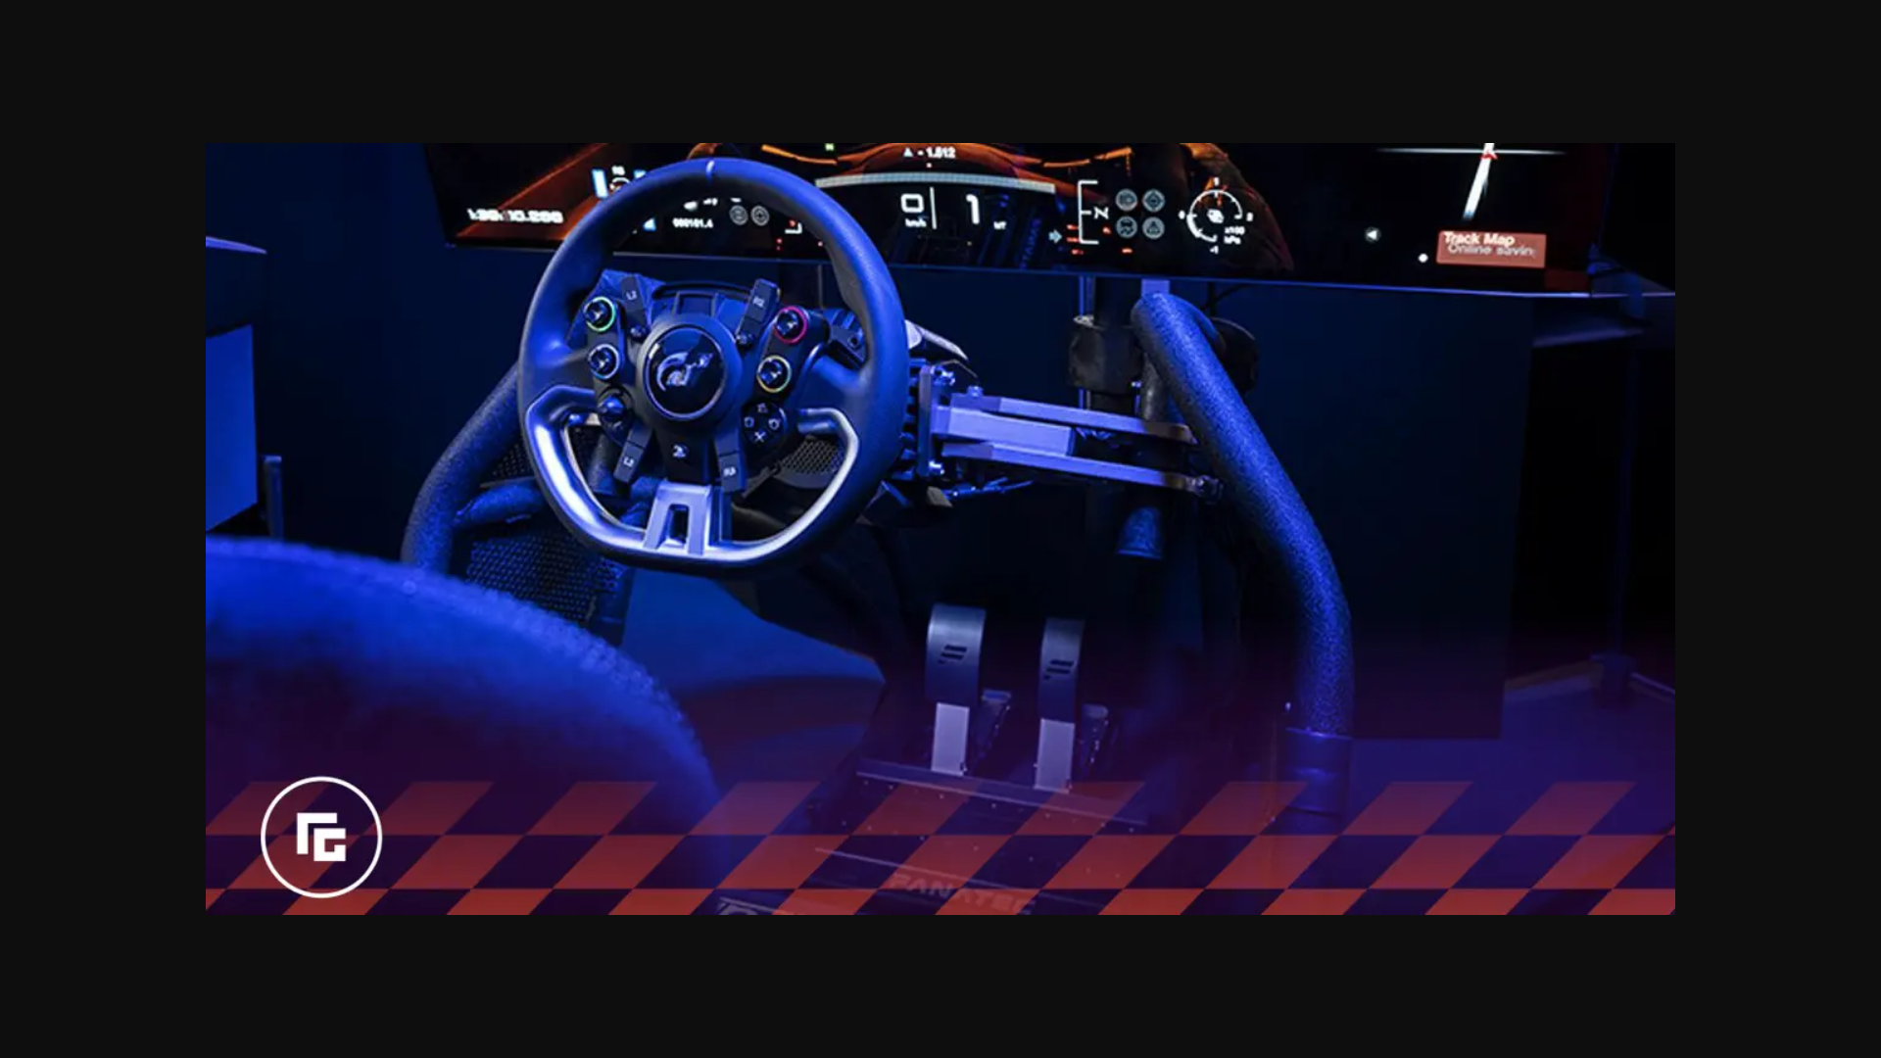
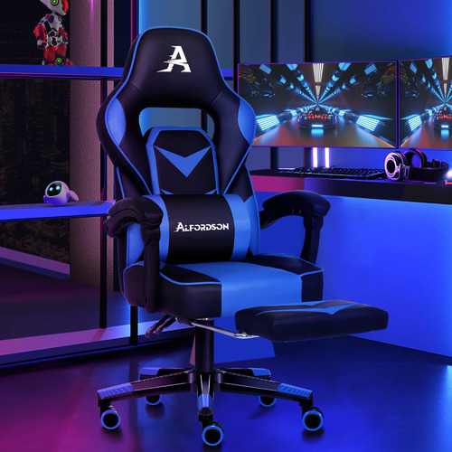
KEY GAMING ACCESSORIES
Sim Racing Wheel
Gaming Chair

Slide 19
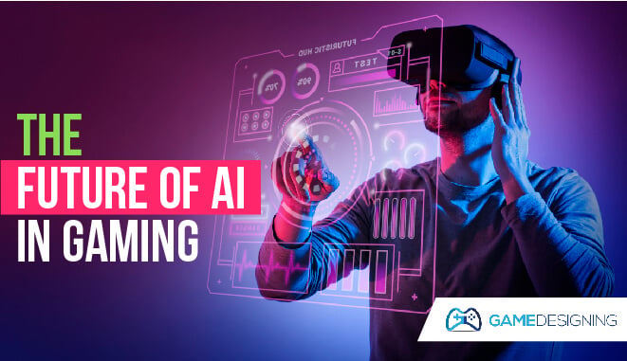
ARTIFICIAL INTELLIGENCE IN VIDEO GAMES
Artificial intelligence has been an integral part of video games since their inception in the 1950s.
AI in video games is a distinct subfield and differs from academic AI.
It serves to improve the game-player experience rather than machine learning or decision making.

Slide 20
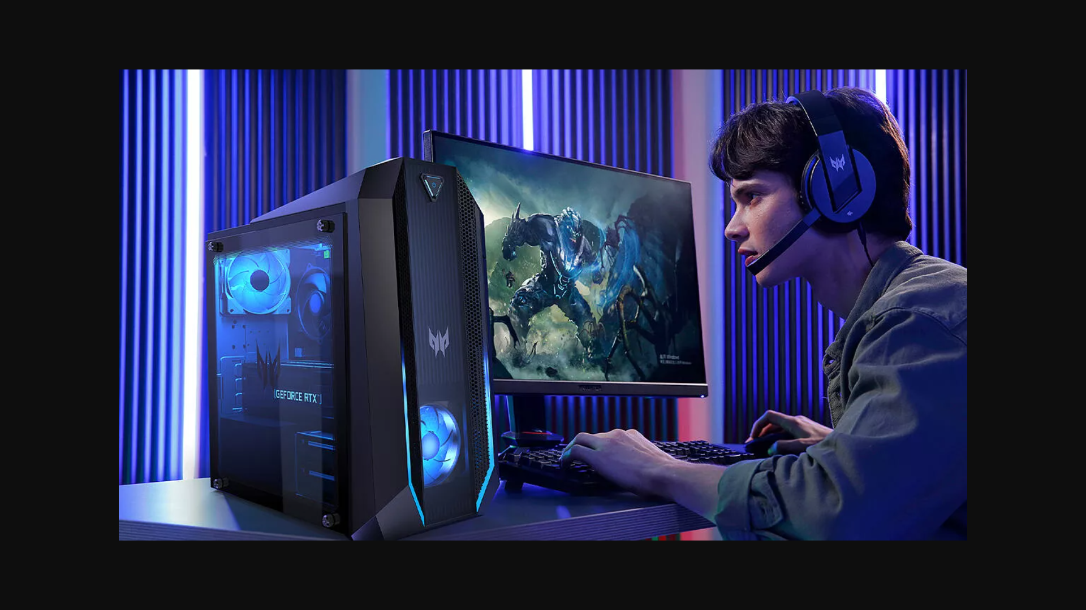
GAMING PCS
PCs have some different advantages, you can customize your PC, the visuals are sharper and more life-like, peripherals are more accurate than a console, and you can modify your games.
You can Customize PC Hardware
The Visuals are Better
Control the way you Play: Gaming Peripherals
You can Rescript Your Rig - or Your Game
PC Games Cost Less

Slide 21
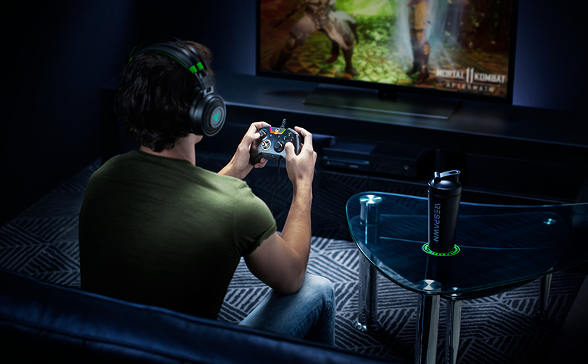
GAMING CONSOLES
Consoles have advantages over PCs,
They are easy to use.
Don't require upgrades.
They're cheaper.
Wireless controllers allow you to have a more active experience.

Slide 22
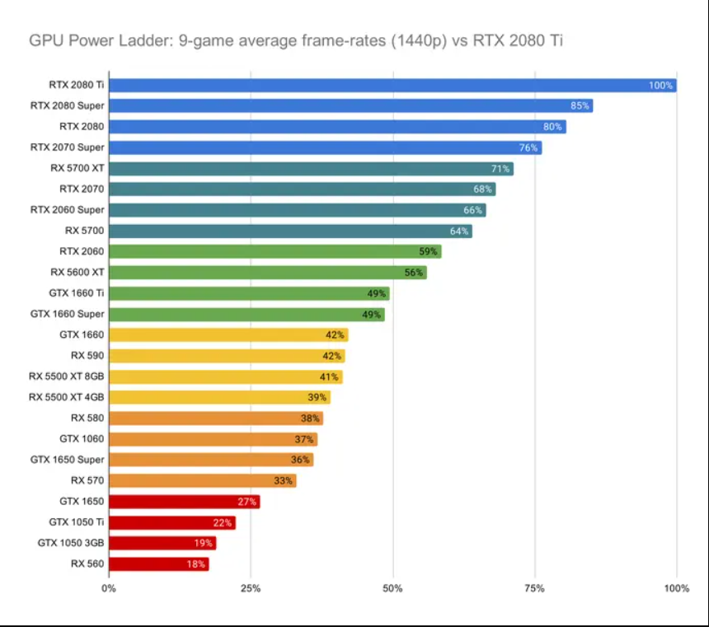
PERFORMANCE
In regard to performance, Windows is one of the best OS for gaming options around, especially Windows.
Windows has been specially designed with games in mind, offering highly reliable performance on even the latest and most technically advanced games you can play.
It also provides users with the power of DirectX 12, which lets you adjust your GPU and CPU settings as needed to maximize frame rates and gaming performance levels.
Nvidia plays major role in performance

Slide 23
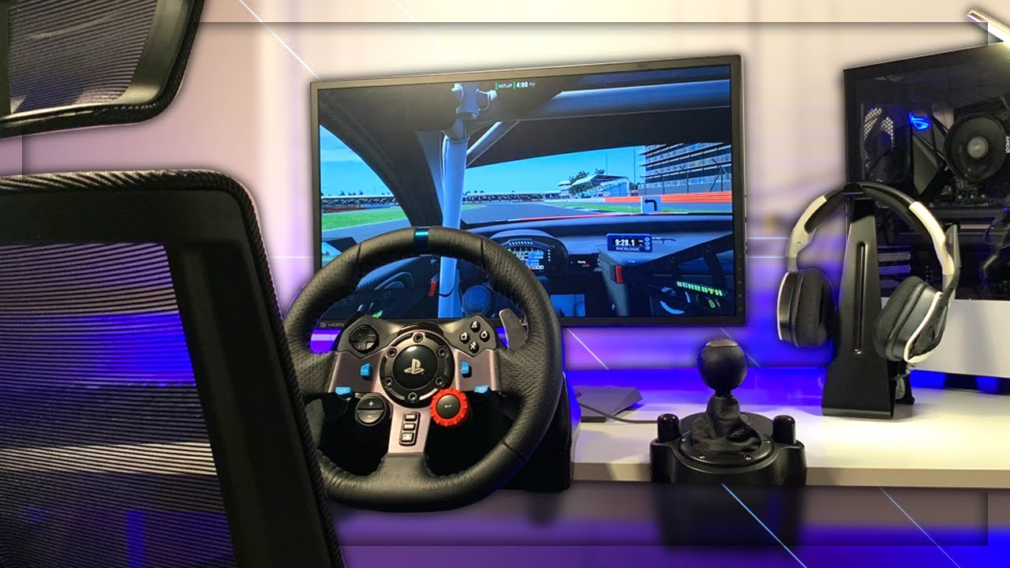
ADVANTAGES
Personal preference
Recycling computers, components, and upgrading
High-end computing
Use of standardized parts and upgrading
Separate OS and driver discs
Educational value and experience
Use of high-quality parts
Cheaper to build

Slide 24
DISADVANTAGES
Poorly-designed systems and cases
Knowledge requirements based on computer hardware and education
Lack of technical support

Slide 25











VARIOUS POPULAR GAMES

Slide 26
Games selection
Biggest and widest selection of games of any OS.
Game developers are aware of this, and so they usually make sure to prioritize Windows versions of their games in order to reach the biggest audiences and get the most potential sales.
Games stores
Steam,
The Epic Games Store,
Uplay,
Origin , etc,…

Slide 27

"Gaming is my therapy."

